Slide 1
Analysis of Algorithms
Short Review on Asymptotic Analysis
[CLRS] – chap. 3, 4.3, 4.4, 4.5

Slide 2
Short Review on Asymptotic Analysis
Asymptotic notations
  Upper bound, Lower bound, Tight bound
Running time estimation in complex cases:
  Summations
  Recurrences
    The substitution method
    The recursion tree method
    The Master Theorem

Slide 3
Review - Asymptotic Analysis
Running time depends on the size of the input
  T(n): the time taken on input with size n
  T(n)=f(n) is an increasing function of n
  it is the rate of growth, or order of growth, of the running time that really interests us
  Look at growth of T(n) as n→∞.
Worst-case and average-case running times are difficult to compute precisely, so we calculate upper and lower bounds of the function.

Slide 4
Review - Asymptotic Notations
O: Big-Oh = asymptotic upper bound
Ω: Big-Omega = asymptotic lower bound
Θ: Theta = asymptotically tight bound
[CLRS] – chap 3 (Growth of functions), chap 4 (Recurrences, Master Theorem)

Slide 5
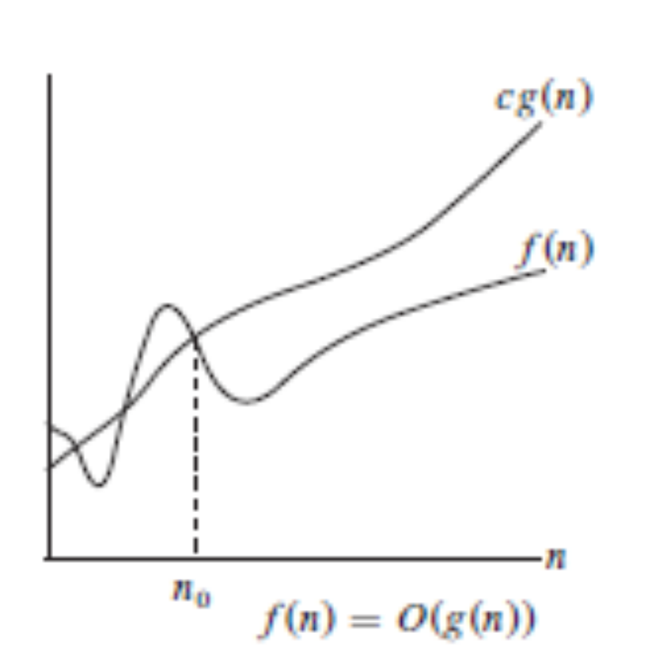
Big O
O (g(n)) is the set of all functions with a smaller or same order of growth as g(n), within a constant multiple
If we say f(n) is in O(g(n)), it means that g(n) is an asymptotic upper bound of f(n)
  Intuitively, it is like f(n) ≤ g(n)
[CLRS], Fig. 3.1

Slide 6
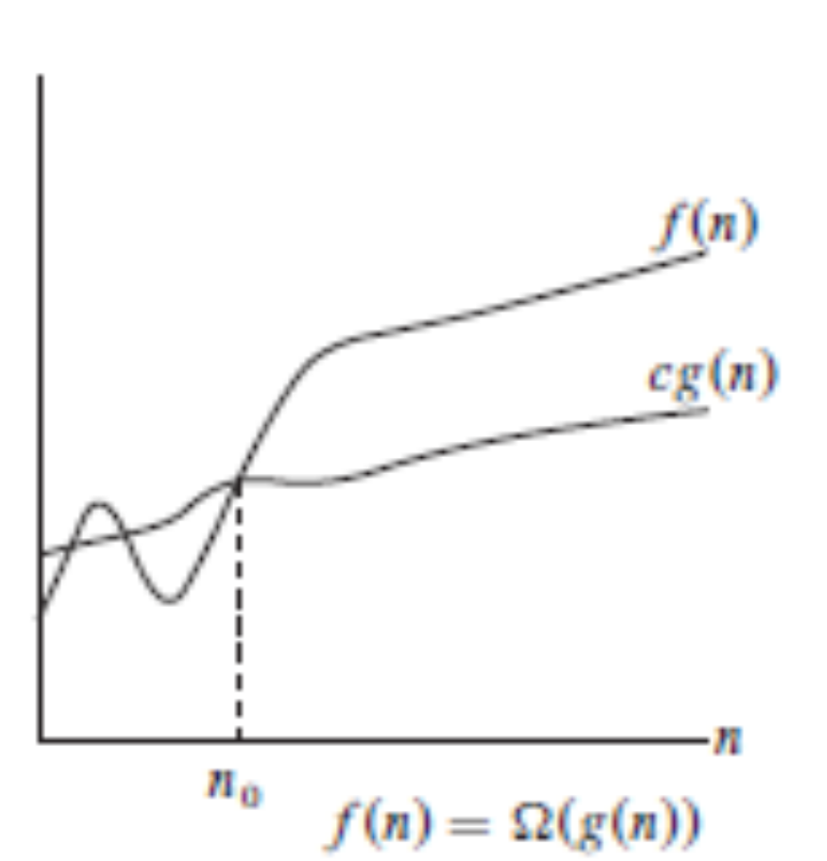
Big Ω
Ω (g(n)) is the set of all functions with a larger or same order of growth as g(n), within a constant multiple
f(n) ∈ Ω(g(n)) means g(n) is an asymptotic lower bound of f(n)
  Intuitively, it is like g(n) ≤ f(n)
[CLRS], Fig. 3.1

Slide 7
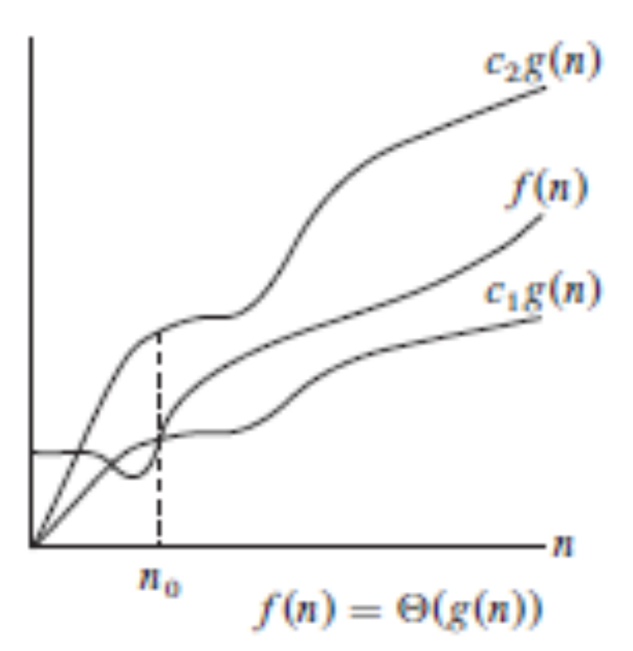
Theta (Θ)
Informally, Θ (g(n)) is the set of all functions with the same order of growth as g(n), within a constant multiple
f(n) ∈ Θ(g(n)) means g(n) is an asymptotically tight bound of f(n)
  Intuitively, it is like f(n) = g(n)
[CLRS], Fig. 3.1

Slide 8
Running Time Estimation
In practice, estimating the running time T(n) means finding a function f(n), such that T(n) in O(f(n)) or T(n) in Θ(f(n))
If we prove that T(n) in O(f(n)) we just guarantee that T(n) “is not worse than f(n)”
  Attention to overapproximations !
If we prove that T(n) is in Θ(f(n)) we actually determine the order of growth of the running time

Slide 9
Running Time Estimation
Simplifying assumption:
  each statement takes the same unit amount of time => count how many operations are executed
  usually we can assume that the statements within a loop will be executed as many times as the maximum permitted by the loop control.
More complex situations when running time estimation can be difficult:
  Summations (a loop is executed many times, each time with a different complexity)
  Recurrences (recursive algorithms)

Slide 10
Summations - Example
For i=1 to n do
  For j=1 to i do
  For k=1 to i do
  something_simple
n
i<=n
O(n³)
i<=n
O(1)
But what about Θ ?
Function something_simple is executed exactly S(n) times:
S(n)= Σ_{i=1}^{n} i² ⁼ n(n+1)(2n+1)/6
S(n) in Θ(n³)
See also: [CLRS] – Appendix A - Summation formulas

Slide 11
Recurrences-Example
p
q
r
MERGE-SORT(A[p..r])
if p < r
q= (p+r)/2
MERGE-SORT(A[p..q])
MERGE-SORT(A[q+1..r])
MERGE(A[p..r],q)
T(n) = Θ(1), n=1
2*T(n/2) + Θ(n), n>1
In case of recursive algorithms, we get a recurrence relationship on the run time function

Slide 12
Solving Recurrences
The recurrence has to be solved in order to find out T(n) as a function of n
General methods for solving recurrences:
  Substitution Method
  Recursion-tree Method

Slide 13
The Substitution Method
The substitution method for solving recurrences:
  do a few substitution steps in the recurrence relationship until you can guess the solution (the formula) and prove it with math induction
Example: applying the substitution method for solving the MergeSort recurrence

Slide 14
Substitution meth: T(n)=2 *T(n/2)+n
T(n) = 2*T(n/2)+n
T(n/2)=2*T(n/2²)+n/2
By substituting T(n/2) in the first relationship, we obtain:
T(n) = 2²*T(n/2²)+2*n/2+n = 2²*T(n/2²)+2*n
T(n/2²) = 2*T(n/2³)+n/2²
T(n) = 2³*T(n/2³)+2²*n/2²+2*n = 2³*T(n/2³)+3*n
..
T(n) = 2^{k}*T(n/2^{k})+k*n (we assume)
T(n/2^{k}) = 2*T(n/2^{k+1})+n/2^{k} (we know by the recurrence formula)
By substituting T(n/2^{k+1}) in the relationship above, we obtain:
T(n)=2^{k+1}*T(n/2^{k+1})+(k+1)*n => assumption proved
T(n) = 2^{k}*T(n/2^{k})+k*n. How many steps k=x are needed to eliminate the recurence ? When n/2^{x}=1 => x=log₂ n
T(n)=n * T(1) + n * log₂ n
Θ(n * log₂ n)

Slide 15
The Recursion Tree Method
The recursion tree method for solving recurrences:
  converts the recurrence into a tree of the recursive function calls.
  Each node has a cost, representing the workload of the corresponding call (without the recursive calls done there). The total workload results by adding the workloads of all nodes. It uses techniques for bounding summations.
Example: applying the recursion tree method for solving the MergeSort recurrence

Slide 16
Recursion tree: T(n)=2 *T(n/2)+n
T(n)
n
n
T(n/2)
T(n/2)
n/2
n/2
T(n/4)
T(n/4)
T(n/4)
T(n/4)
The recursion tree has to be expanded until it reaches its leafs.
To compute the total runtime we have to sum up the costs of all the nodes:
  Find out how many levels there are
  Find out the workload on each level

Slide 17
Recursion tree: T(n)=2 *T(n/2)+n
n
n
n/2
n/2
n
log ₂ n
n/4
n/4
n/4
n/4
n
T(1)
T(1)
T(1)
T(1)
T(1)
T(1)
T(1)
T(1)
n
Θ(n * log₂ n)

Slide 18
Solving Recurrences
A particular case are the recurrences of the form T(n)=aT(n/b)+f(n), f(n)=c*n^{k}
  this form of recurrence appears frequently in divide-and-conquer algorithms
The Master Theorem: provides bounds for recurrences of this particular form
  3 cases, according to the values of a, b and k
  Can be proved by substitution or recursion-tree
[CLRS] chap 4

Slide 19
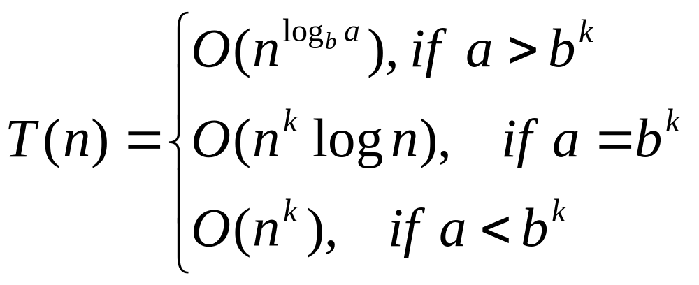
The Master Theorem
Provides bounds for recurrences of the form T(n)=aT(n/b)+f(n), f(n)=c*n^{k}
  3 cases, according to the values of a, b and k
  Can be proved by substitution or recursion-tree [CLRS] chap 4

Slide 20
Merge-sort example
T(n) = Θ(1), n=1
2*T(n/2) + Θ(n), n>1
The recurrence relation of Merge-sort is a case of the master theorem, for a=2, b=2, k=1
Case a=b^{k} => Θ(n^{k} * log n), k=1 ^{=>} Θ(n * log n)

Slide 21
Difficult recurrences
Some recurrences can be difficult to solve mathematically, thus we cannot directly determine a tight bound (Theta) for their running times.
In this cases, we can apply one of the following strategies:
  Strategy 1: Try to determine a lower bound (Omega) and an upper bound (O).
  Stragtegy 2: Guess a function for the tight bound and prove that it verifies the recurrence formula (The “Guess and prove” approach)

Slide 22
Example: Recursive Fibonacci
function Fibonacci (n:integer) returns integer is:
if (n==1) or (n==2)
return 1
else
return Fibonacci (n-1) + Fibonacci (n-2)
T(n) = c1, n<=2
T(n-1) + T(n-2) + c2, n>2
This recurrence is difficult to solve by substitution or call tree.
We have to try something else.

Slide 23
Example: Computing Lower and upper bounds
We always should try to do our best:
  find a lower bound which is the highest lower bound that we can prove, and
  find an upper bound which is the lowest upper bound that we can prove.
If we can prove the same function both for lower bound and upper bound, then we even managed to find the tight bound (Theta).

Slide 24
Example: Upper bound for Fibonacci
T(n) = c1, n<=2
T(n-1) + T(n-2) + c2, n>2
T(n) is in O(f(n)), if there exist a>0, n0>0, such that T(n)<=a*f(n), for all n>=n0.
For any algorithm, we have: T(n-2)<=T(n-1)
Taking this into account (replacing T(n-2) with the bigger T(n-1)), the Fibonacci recurrence leads to:
T(n)=T(n-1)+T(n-2)+c2 <= 2*T(n-1) + c2

Slide 25
Example: Upper bound for Fibonacci (cont)
T(n)=T(n-1)+T(n-2)+c2 <= 2*T(n-1) + c2
By substitution,
T(n)<= 2^k *T(n-k) + c2 (2^(k-1) + 2^(k-2) + .... + 2^2 +2 +1)
Substitution stops when n-k=1, k=n-1
Results that T(n)<= a* 2^n
T(n) is in O(2^n)

Slide 26
Example: Lower bound for Fibonacci
T(n) = c1, n<=2
T(n-1) + T(n-2) + c2, n>2
T(n) is in Omega(f(n)), if there exist b>0, n0>0, such that T(n)>=b*f(n), for all n>=n0.
For any algorithm, we have: T(n-2)<=T(n-1), T(n-3)<=T(n-2), ... T(n-k)<=T(n-k+1)
Taking this into account, replacing T(n-1) by the smaller T(n-2), the Fibonacci recurrence leads to:
T(n)=T(n-1)+T(n-2)+c2 >= 2*T(n-2) + c2

Slide 27
Example: Lower bound for Fibonacci (cont)
T(n)=T(n-1)+T(n-2)+c2 >= 2*T(n-2) + c2
By substitution,
T(n)>= 2^k *T(n-2*k) + c2 ( 2^(k-1)) + .... + 2^2 +2 +1)
Substitution stops when k=n/2
Results that: T(n)>= b* 2^(n/2)
T(n) is in Omega(2^(n/2))

Slide 28
Example: Guess and prove
By upper and lower bounds we found that Fibonacci time is:
b* 2^(n/2) <=T(n) <= a* 2^n
We presume that T(n)=x^n. We have to prove this (to find the value of x)
T(n)=T(n-1)+T(n-2)+c2
x^n = x^(n-1)+ x^(n-2)
x^2 – x-1 = 0 => x=1.618 Fibonacci is Θ (x^n)

Slide 29
Conclusions
We estimate asymptotic complexity with: Upper Bound (Big-O), Lower Bound (Big-Omega) and Tight Bound (Big-Theta).
Determining the asymptotic complexity of recursive algorithms can be difficult. For this, you will have to solve the recurrence relationship that describes the recursive algorithm.
General methods for solving recurrence relationships are the substitution method and the recursion-tree method. For certain particular types of recurrences (the divide-and-conquer type of recurrences) the result is also given by the Master Theorem.
Sometimes solving certain recurrence relationships is mathematically difficult and we cannot calculate the tight bound. In this case we can introduce approximations, that will help us determine only lower bounds and upper bounds. Guess and prove also works sometimes.

Slide 30
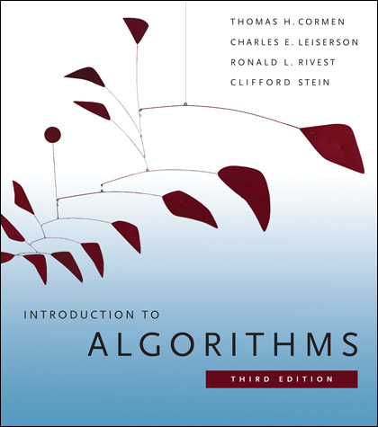
Further Reading
[CLRS] – Chapters 3, 4.4, 4.4, 4.5
Additional exercises: http://staff.cs.upt.ro/~ioana/algo/lab_analysis.html

